Slide 1
ADTest Framework POC
NITIN JOSE PAUL

Slide 2
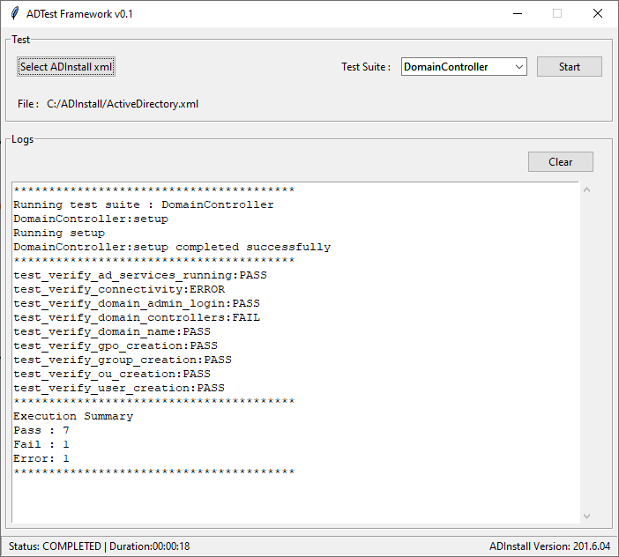
Features & Components
A small UI developed using Python Tkinter
Test section to configure and start test execution.
Logs section with high level logs.
Status Bar with execution status.

Slide 3
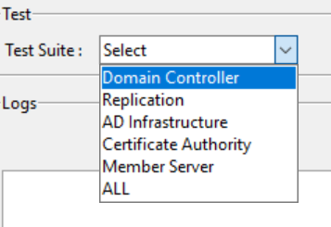
Features & Components
Provision to run specific test suites or all together.
Each test suite will be a class
Each test case will be a method

Slide 4
Features & Components
Logger with multiple handlers
high level console logging and detailed file logging
Filtered on basis of log level (DEBUG, INFO, WARNING, ERROR)
Test Executor module
Provides automatic discovery of test suites
Executes test suites based on selection
Bundled using pyinstaller
App can run on test setups without installing Python

Slide 5
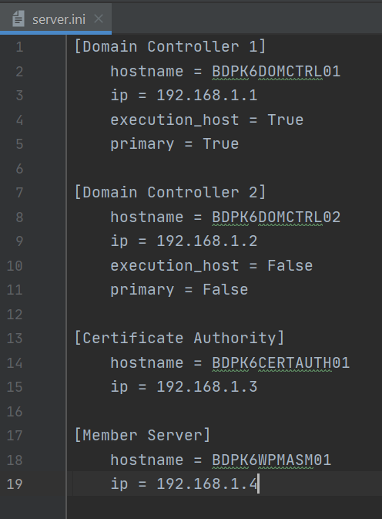
Input files for ADTest
AD XML File
Config file used for ADInstall
Server INI file
Details for each server in a setup

Slide 6
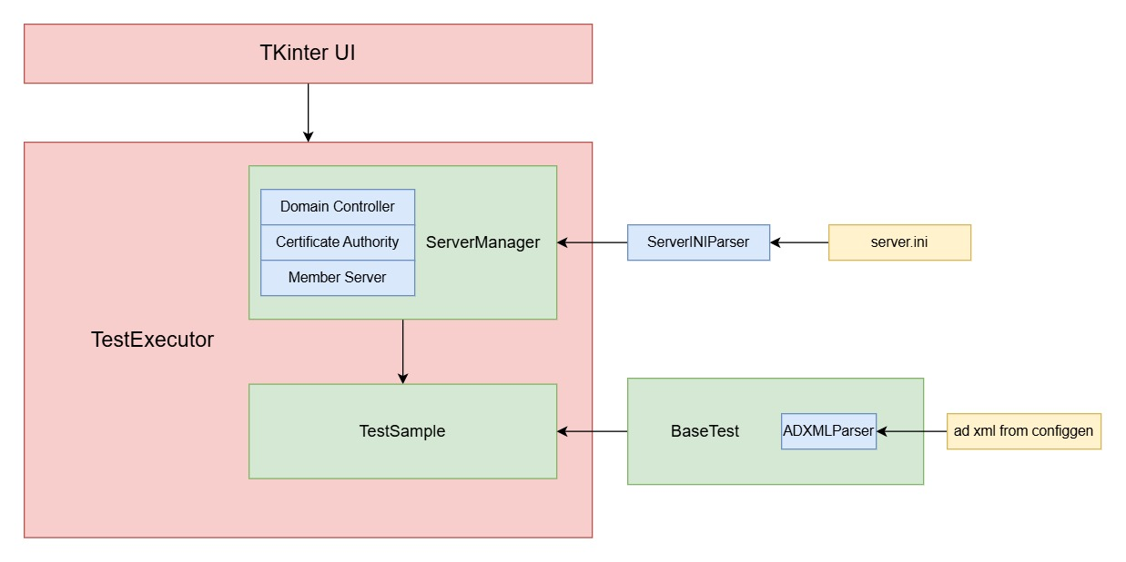
Control Flow

Slide 7
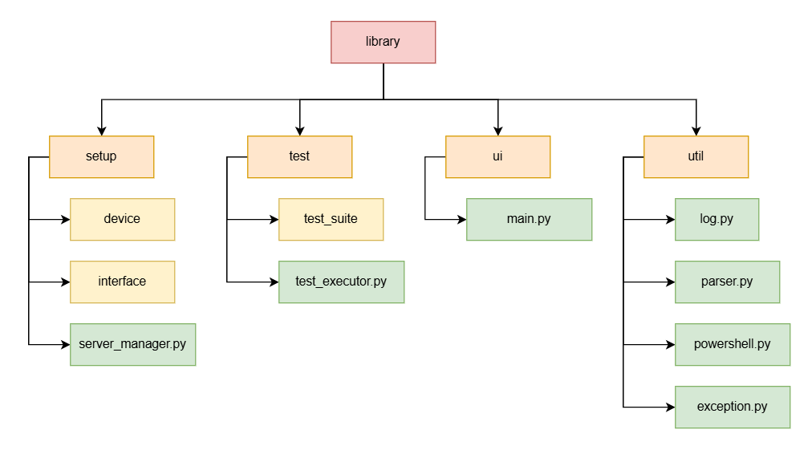
Folder Hierarchy

Slide 8
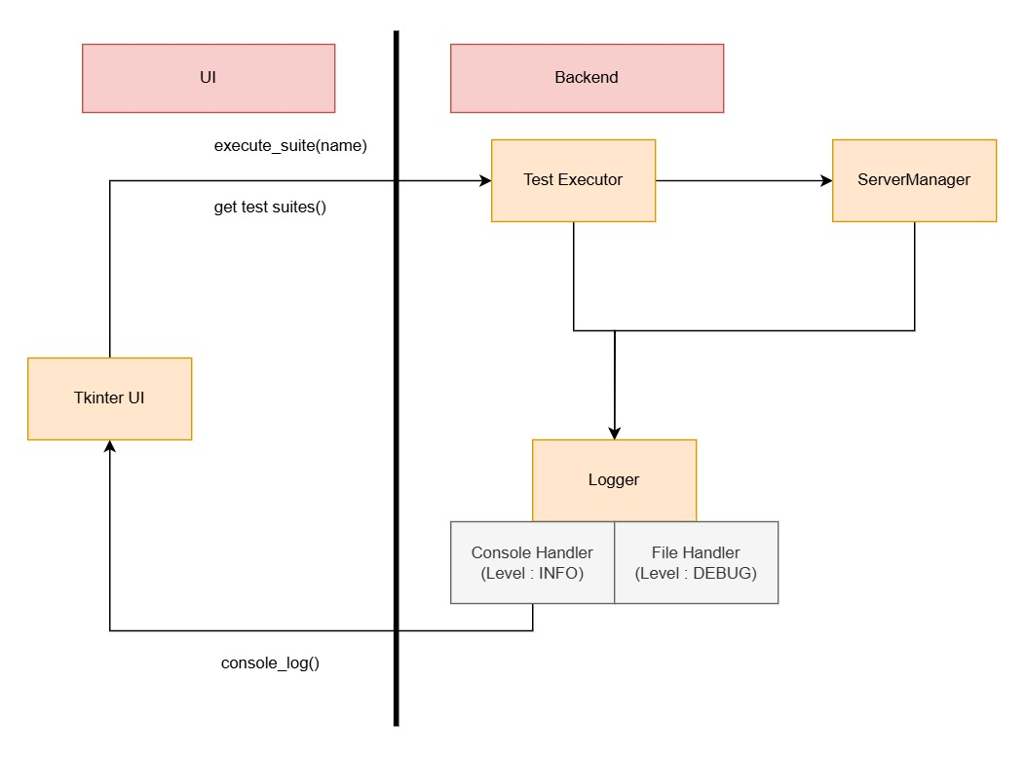
UI – Backend Interaction

Slide 9
Thank You

